Slide 1

Unraveling Unemployment
Project by: Cipher-Byte Technologies
Presented by: Naman Shrotriya

Slide 2
Data Loading and Cleaning
Imported necessary libraries: Pandas, NumPy, Matplotlib, Seaborn. Loaded the dataset from 'unemployment_data.xlsx'. Checked for missing values: None found. Dropped rows with missing values.

Slide 3
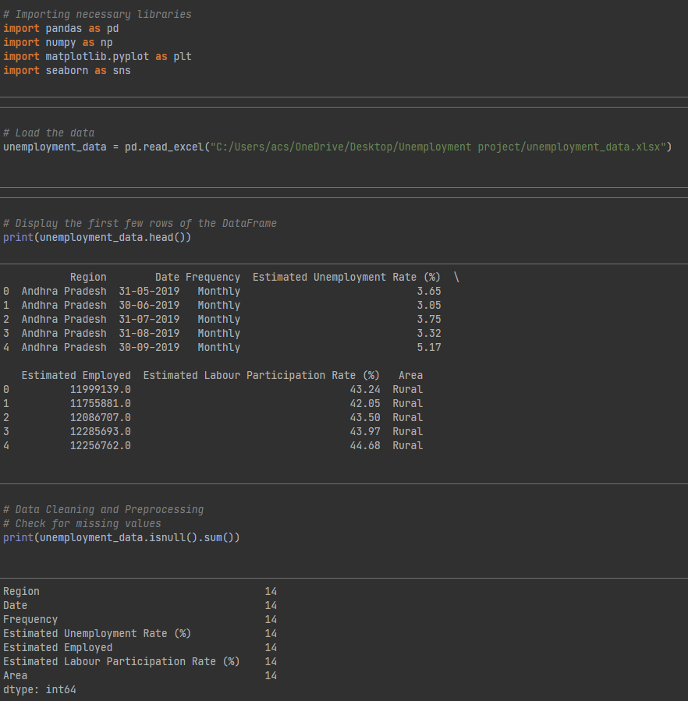
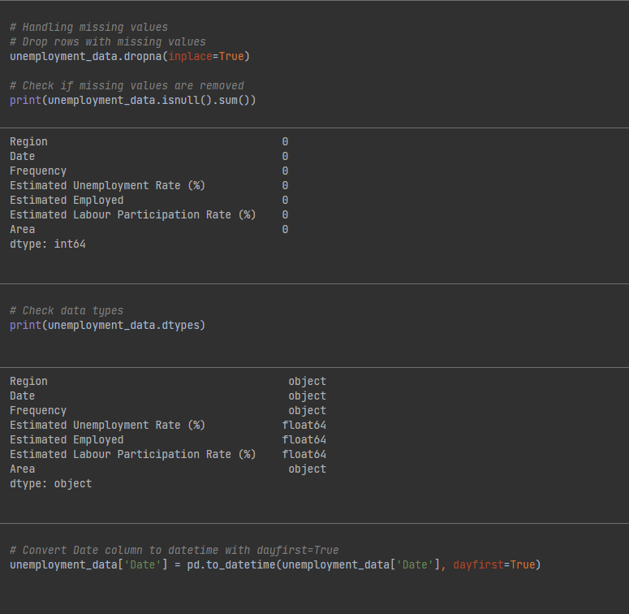

Slide 4
Exploratory Data Analysis (EDA)
Summary statistics: Descriptive statistics of the dataset. Visualizations: Line plot of Unemployment Rate over time, Histogram of Unemployment Rate, Bar plot of Average Unemployment Rate by Region, Scatter plot of Unemployment Rate vs. Labour Participation Rate with color mapping to Region, Heatmap of Correlation Matrix, Pairplot to visualize relationships between multiple variables.

Slide 5
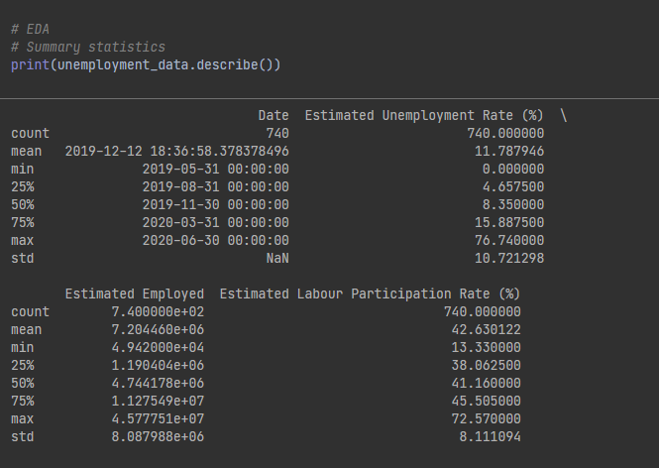

Slide 6
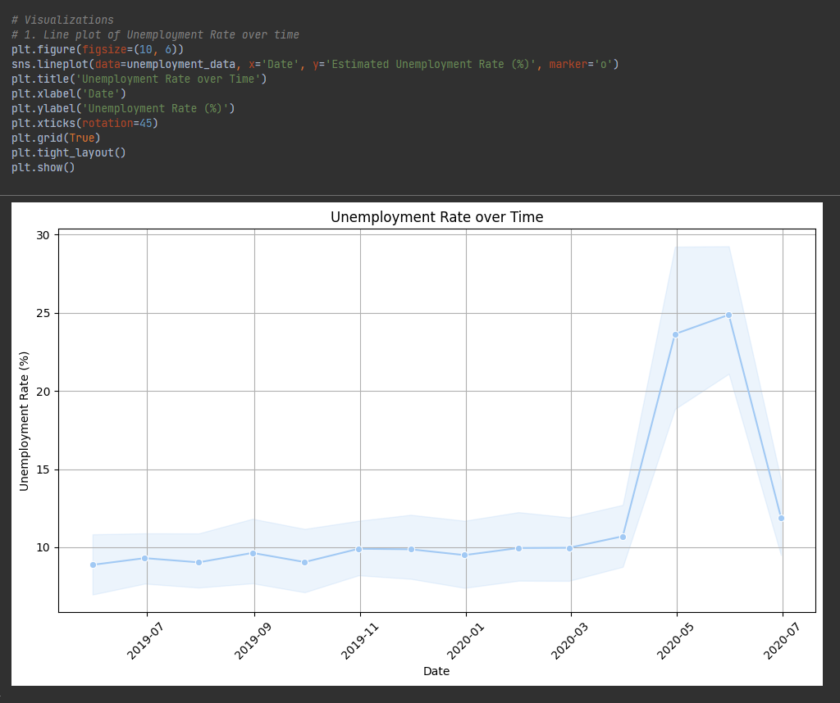

Slide 7
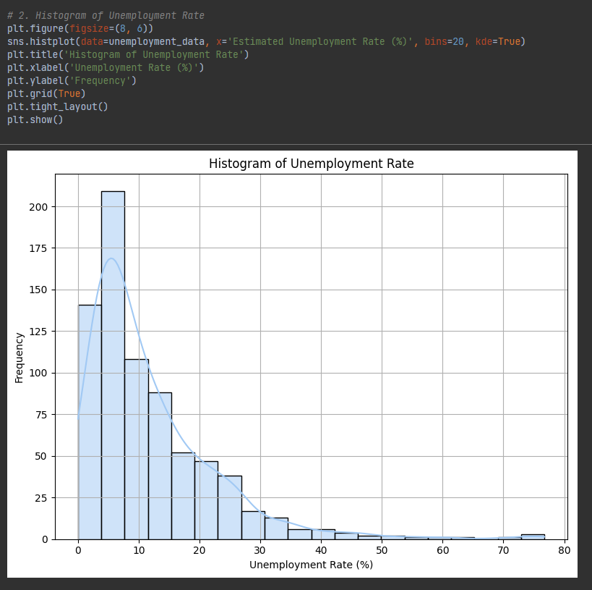

Slide 8
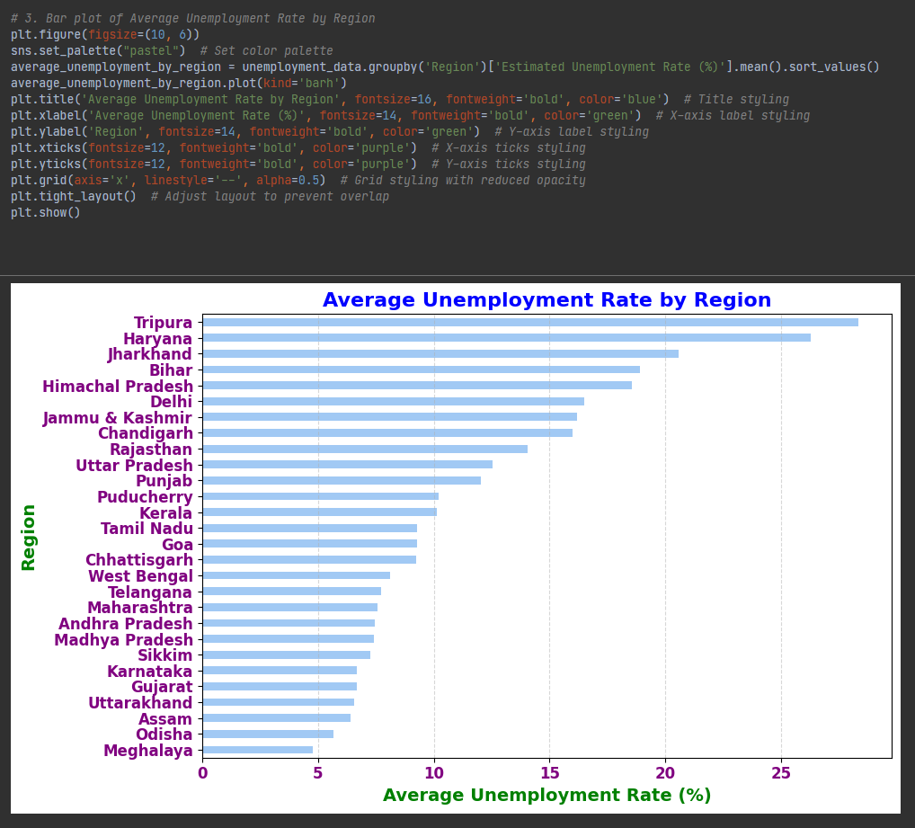

Slide 9
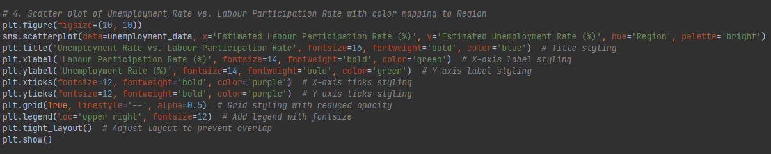
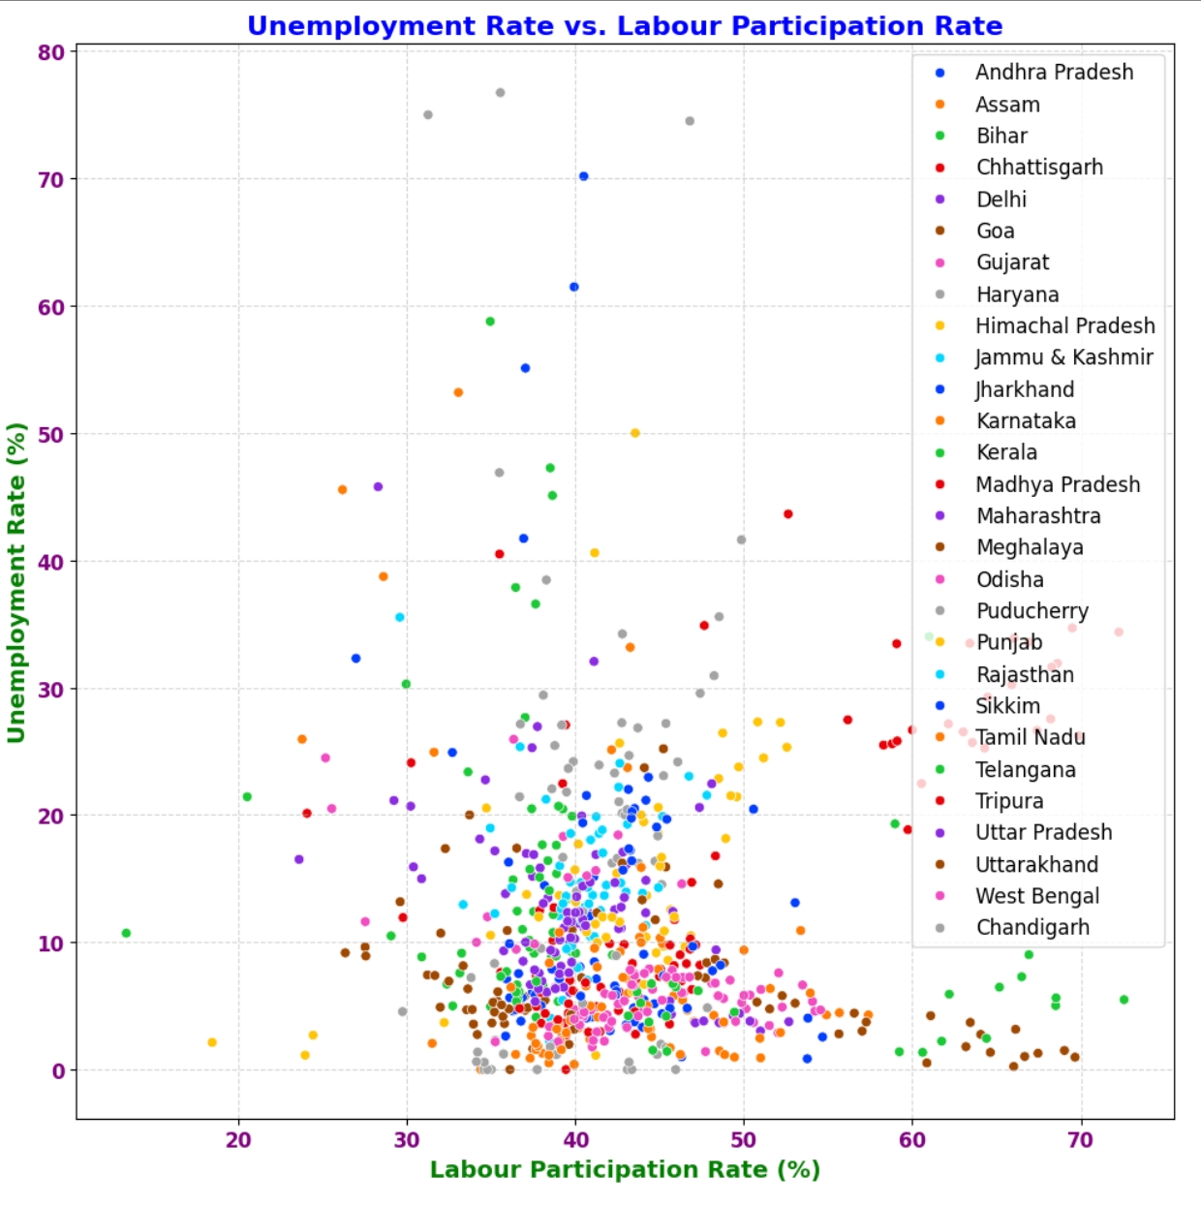

Slide 10
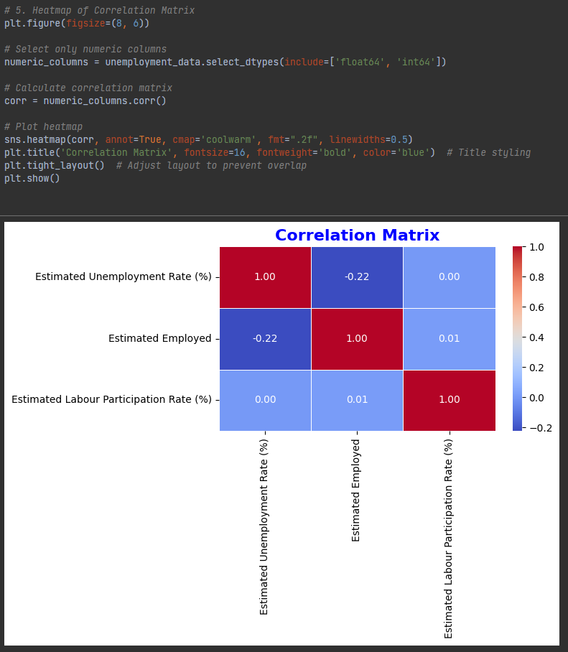

Slide 11
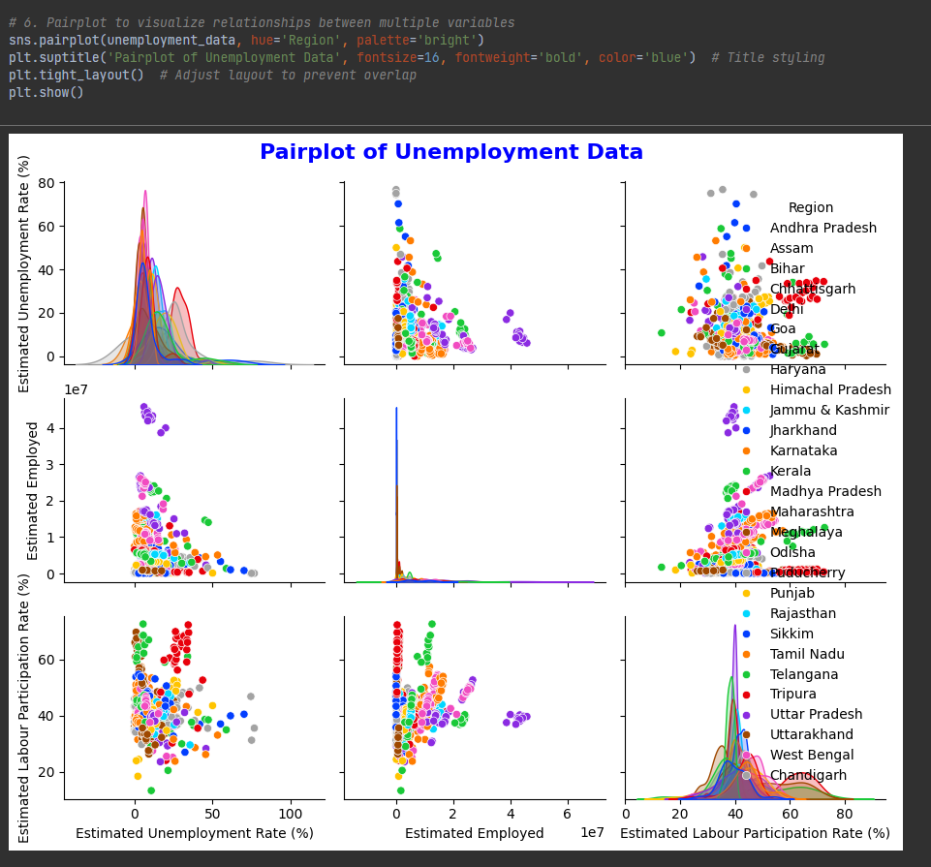

Slide 12
Q1. What is the trend of the unemployment rate over time?
Answer: By analyzing the line plot , we can observe the fluctuation in the unemployment rate over different time periods. From the visualization, we can infer whether the unemployment rate has been increasing, decreasing, or remaining relatively stable over time.
Q2. What is the distribution of the unemployment rate across different regions?
Answer: The bar plot visualizes the average unemployment rate by region. By examining this plot, we can identify which regions have higher or lower unemployment rates on average compared to others.
Q3. Is there any relationship between the unemployment rate and the labor participation rate?
Answer: The scatter plot illustrates the relationship between the unemployment rate and the labor participation rate. By analyzing this plot, we can determine whether there is a correlation between these two variables. Additionally, the color mapping to regions helps in identifying any regional patterns in this relationship.

Slide 13
Q4. Are there any correlations among different numeric variables in the dataset?
Answer: The heatmap of the correlation matrix provides insights into the relationships between different numeric variables such as the unemployment rate, labor participation rate, etc. By examining the correlation coefficients, we can identify which variables are positively or negatively correlated with each other.
Q5. How does the unemployment rate vary across different regions?
Answer: The pair-plot visualizes multiple relationships within the dataset, including the unemployment rate across different regions. By examining the pair-plot, we can observe how the unemployment rate varies within each region and whether there are any notable patterns or outliers.

Slide 14
Conclusion
The analysis of the unemployment data reveals fluctuating trends in the unemployment rate over time, indicating its dynamic nature.
Regional disparities exist, with some regions exhibiting higher average unemployment rates.
The scatter plot suggests a potential negative correlation between unemployment rate and labor participation.
Additionally, the correlation matrix highlights relationships among variables. Overall, the analysis underscores the need for targeted interventions to address regional disparities and promote labor market participation for economic stability.

